Slide 1

Statistics Review
Presented by:
Elizer Ponio Jr.

Slide 2
What can Statistics do?
Statistics are tools that help us make sense of the vast amount information in the world.
Statistics help us filter the loads of data that come at us every day.
Statistics help us reason, not reason for us.

Slide 3
Descriptive Statistics
Descriptive statistics describe what the data show.
Descriptive statistics usually include things like where the middle of the data is and measures of how spread out the data are.
Descriptive statistics make the data we get more digestible.

Slide 4
Inferential Statistics
Inferential statistics allow us to make inferences (conclude from evidence).
Inferential statistics allow us to make conclusions that extend beyond the data we have in hand.
Inferential statistics can help us make decisions about data if there is uncertainty.

Slide 5
Mean
Mean is the arithmetic average of a data set.
The middle number if we lined up our data from smallest to largest.

Slide 6
Median
The median is the middle number in a data set.

Slide 7
Mode
The mode is the value that occurs the most often in a data set
The word mode comes from the latin word modus, which means “manner, fashion or style” and gives us the French expression a la mode, meaning fashionable

Slide 8
Distribution
A distribution shows us how often each value occurs in a data set.

Slide 9
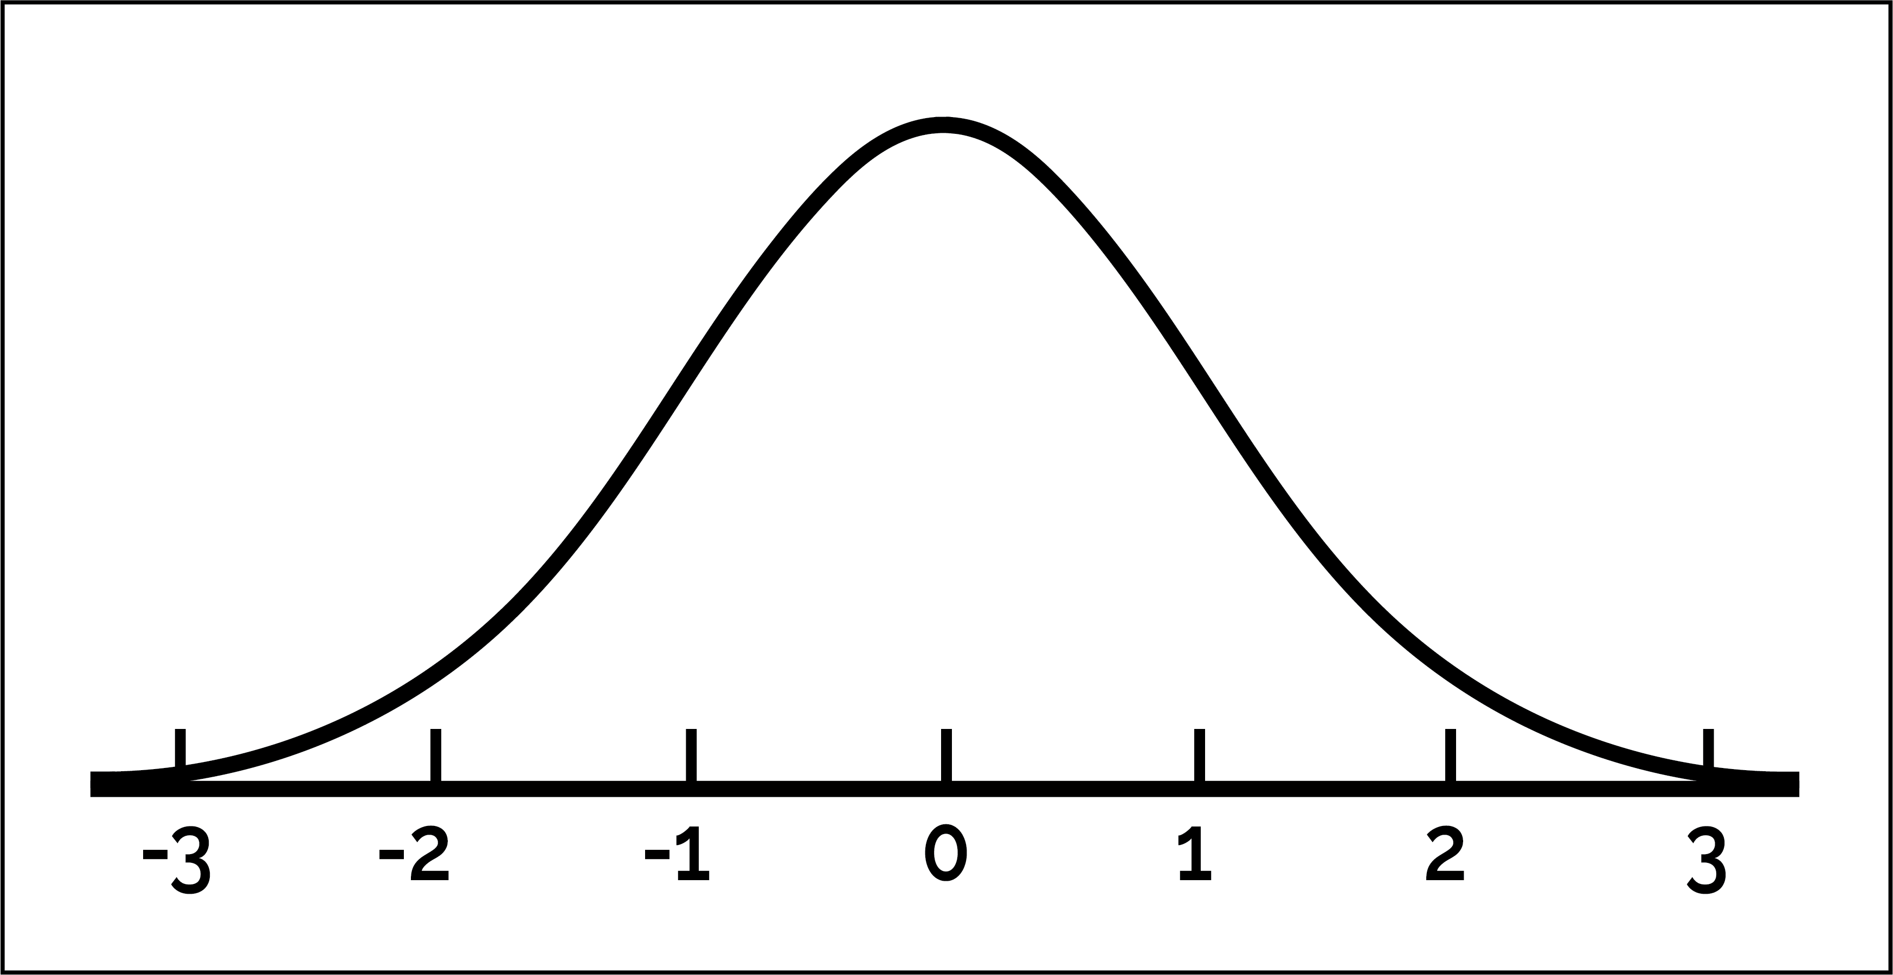
Normal
A distribution of data that has roughly the same amount of data on either side of the middle, and has its most common values around the middle of the data.
Data that are distributed normally have a symmetrical bell shape.

Slide 10
Symmetric Distribution
When the median and the mean are the same, it means that the distribution is symmetric.
Symmetric data means that there is an equal amount of data on either side of the median and equal amounts on either side of the mean.

Slide 11
Skewed Distribution
When the median and the mean are the different, it means that the distribution is skewed.
Skewed means that there are some unusually extreme values on one side of the distribution, either large or small.

Slide 12
Skewed Distribution
If the mean is a lot higher than the median or mode, it tells you that there are values that are relatively large in the dataset.
If the mean is a lot lower than the median or mode, it tells you that there are values that are relatively small in the dataset.

Slide 13
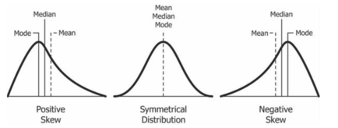

Slide 14
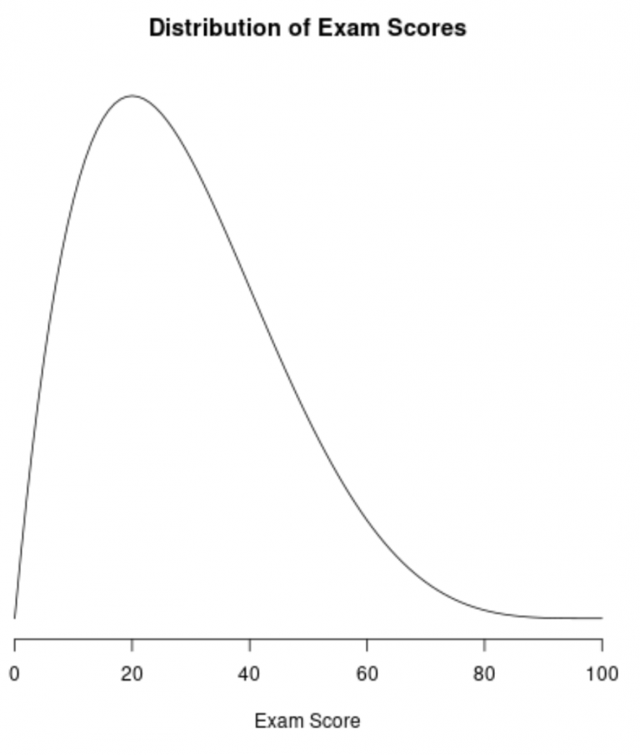

Slide 15
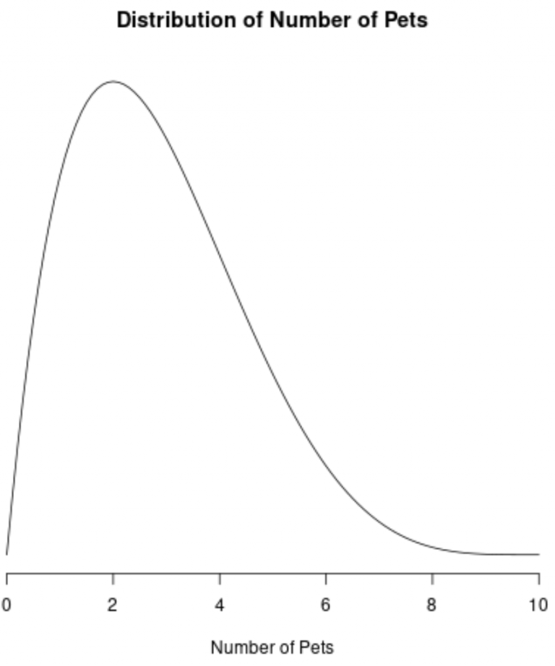

Slide 16
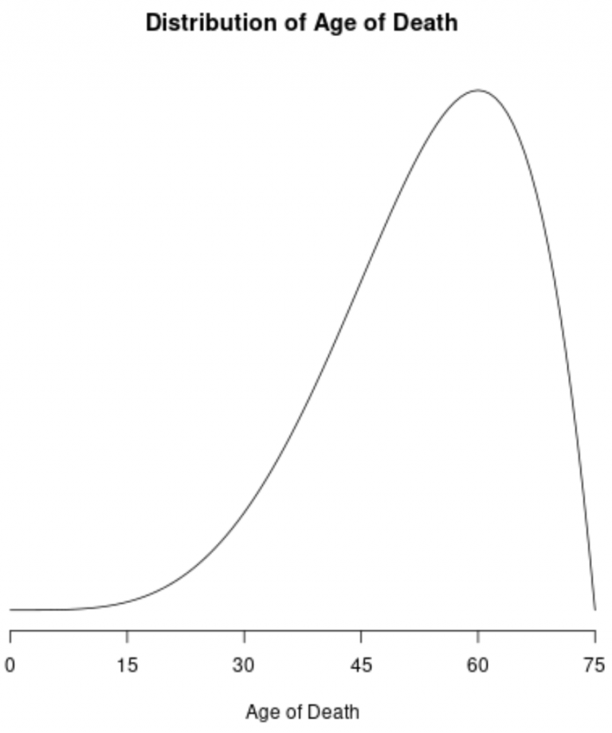

Slide 17
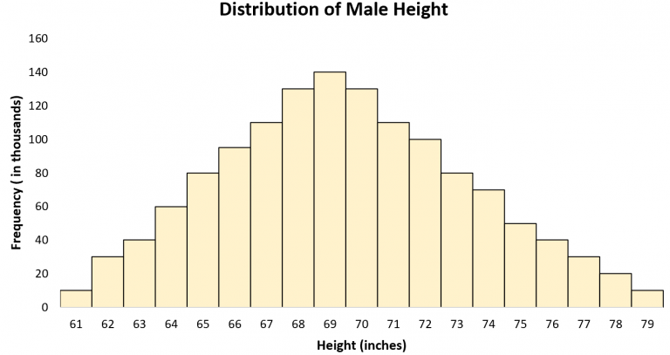

Slide 18
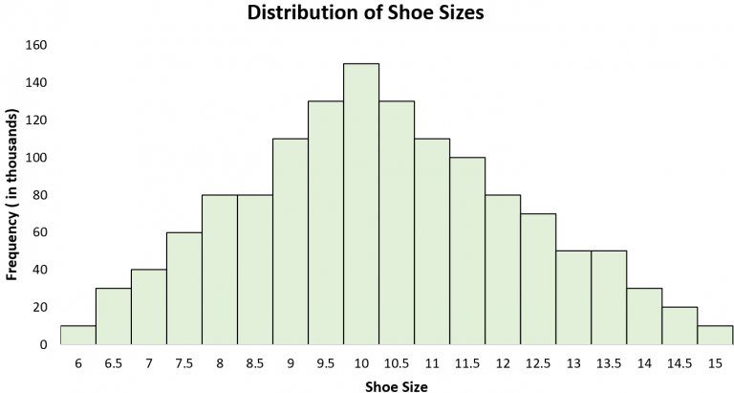

Slide 19
Range
The range is the difference between the highest and lowest values in a data set.
Range takes the largest number in the data set and subtracts the smallest number in the set to give us the distance between these two extremes. The larger the distance, the more spread out our data is.

Slide 20
Mean, Median, Mode and Range
1. What is the mean, median, mode and range of the following data set: 10, 7, 14, 23, 15, 7, 32

Slide 21


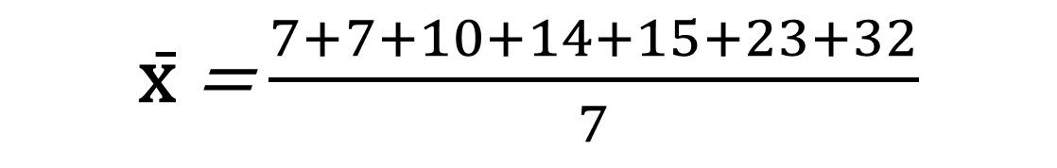
Mean
x̄ = $\frac{7+7+10+14+15+23+32}{7}$
x̄$=$ $\frac{108}{7}$
x̄$=$ $15.43$

Slide 22
Median
7, 7, 10, 14, 15, 23, 32
median = 14

Slide 23
Mode
7, 7, 10, 14, 15, 23, 32
mode = 7

Slide 24
Range
7, 7, 10, 14, 15, 23, 32
range = 32 – 7
range = 25

Slide 25
Mean, Median, Mode and Range
2. What is the mean, median, mode and range of the following data set: 15, 21, 59, 15, 37, 59, 11, 41

Slide 26
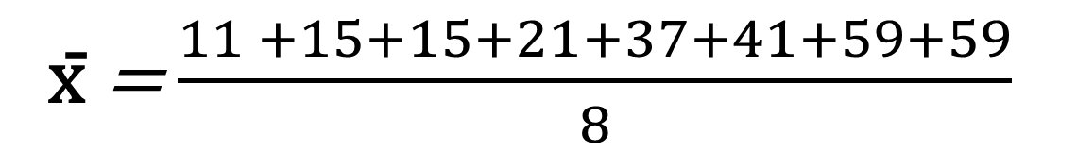

Mean
x̄ = $\frac{11 +15+15+21+37+41+59+59}{8}$
x̄$=$ $32.25$

Slide 27

Median
11, 15, 15, 21, 37, 41, 59, 59
median $=$ $\frac{21+37}{2}=\frac{58}{2}=29$

Slide 28
Mode
11, 15, 15, 21, 37, 41, 59, 59
mode = 15, 59

Slide 29
Range
11, 15, 15, 21, 37, 41, 59, 59
range = 59 – 11
range = 48

Slide 30
Data Visualization
Categorical Data. Does not have a meaningful order or consistent spacing.
Quantitative Data. Numbers that have both order and consistent spacing.

Slide 31
Frequency Table
Class | Frequency
Freshman | 5000
Sophomore | 3000
Junior | 1000
Senior | 1000
Total Student Population: 10000

Slide 32
Relative Frequency Table
Class | Frequency | Relative Frequency
Freshman | 5000 | 50%
Sophomore | 3000 | 30%
Junior | 1000 | 10%
Senior | 1000 | 10%
Total Student Population: 10000

Slide 33
Bar Chart

Slide 34
Bar Chart

Slide 35
Pie Chart

Slide 36

Pictograph
Freshman
Sophomore
Junior
Senior

